Slide 1
Digitalization of Training Contents for Middle Schools 2020-1TR01-KA226-SCH-098485
Reuniune transnațională, București, 28 februarie-1 martie 2022
Project Number: 2020-1-TR01-KA226-SCH-098485 Funded by the Erasmus+ Program of the European Union. However, European Commission and Turkish National Agency cannot be held responsible for any use which may be made of the information contained therein.

Slide 2
MEETING AGENDA O1.My Digital Class WP1.Framework of Digital Learning Outcomes for Science, Mathematics and English Presentation of draft version of the IO1.WP1.Framework of Digital Learning Outcomes for Science, Mathematics and English (BOUN) Qs & As (All) Next Steps and Tasks (All)
O1.My Digital Class WP2.Defining the Digital Training Content and the Methodology According to the LOs defined Presentation of the draft workplan for IO1.WP2.Defining the Digital Training Content and the Methodology According to the LOs defined (GoI) Discussions on the activity design (All) Qs & As (All) Next Steps and Tasks (All)
O1.My Digital Class WP3. Digitools Platform Presentation of the Digitools website and platform (GoI) Qs & As (All) Next Steps and Tasks (All)

Slide 3
O2.Assessment and Evaluation Compass Progress done so far (GoI) Presentation of the tools for IO1.WP1.Analysis (All) Discussions on the design (All) Next Steps and Tasks (All)
IO3.Teachers As Mentors Guidebook – coord ISJI Presentation of IO3.WP3. The workplan for defining the digital coaching skills for teachers (IASI) Presentation of the good practices template (IASI) Presentation of questionnaires for focus group meeting (INFODEF) General Discussions on the improvement (All) Next Steps and Tasks (All)

Slide 4
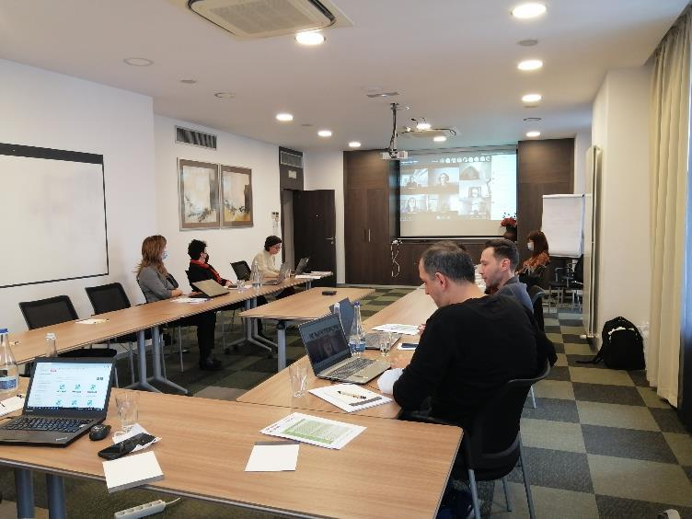

Slide 5
